Slide 1
Heart Disease Prediction
University of Chicago
Machine Learning – Final Presentation
Nicolas, Jaird, Oluwafemi and Pujing
June 2021

Slide 2




Team Introduction
United States
of America
China
Name - Jaird Meyer
Industry – Tech and Media
Experience – 3yrs
Email – jairdm@uchicago.edu
Name - Pujing Yang
Industry – Consulting
Experience – 2
Email – pyang1@uchicago.edu
Colombia
Nigeria
Name - Nicolas Yanez
Industry – Healthcare
Experience – 4yrs
Email – nyanez@uchicago.edu
Name - Oluwafemi Fabiyi
Industry – Big4 Consulting
Experience – 11yrs
Email – fabiyio@uchicago.edu

Slide 3
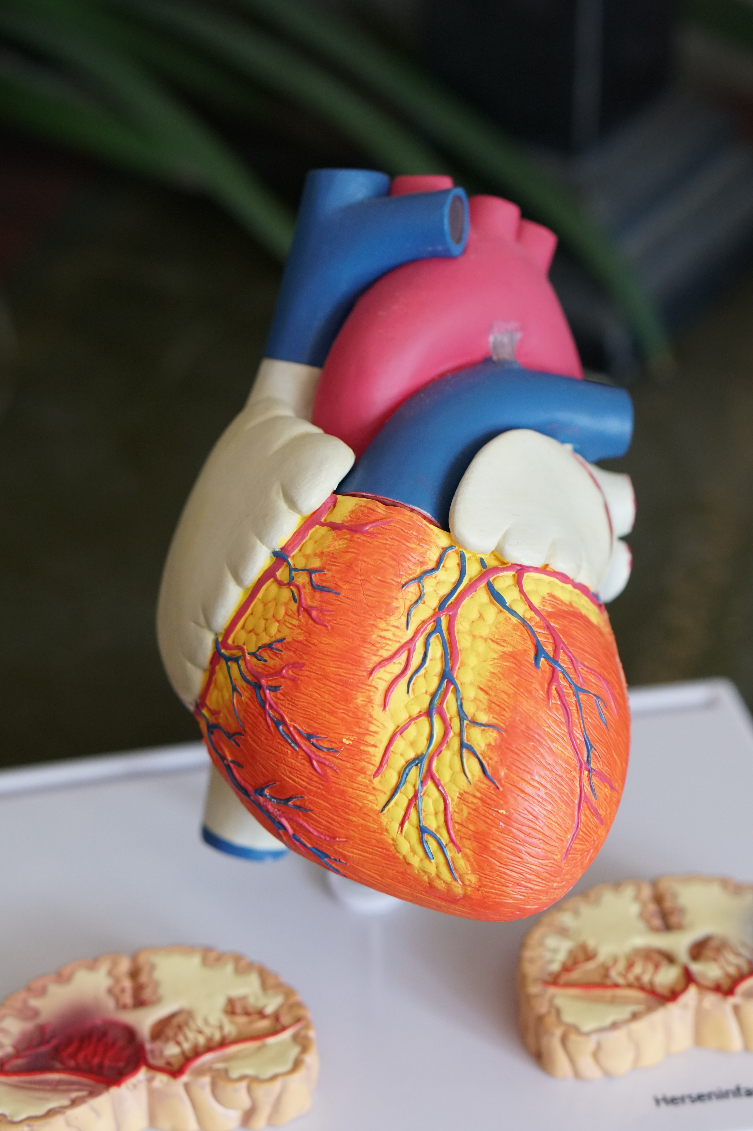
Contents
Lessons Learnt
Page 17
9
1
Executive Summary
Page 4
Recommendations
Page 16
8
2
Research Objective
Page 5
Modeling
Page 13
7
3
Overall Approach
Page 5
Data Preparation
Page 10
6
4
Data Overview
Page 7
5
Exploratory Data Analysis
Page 8

Slide 4
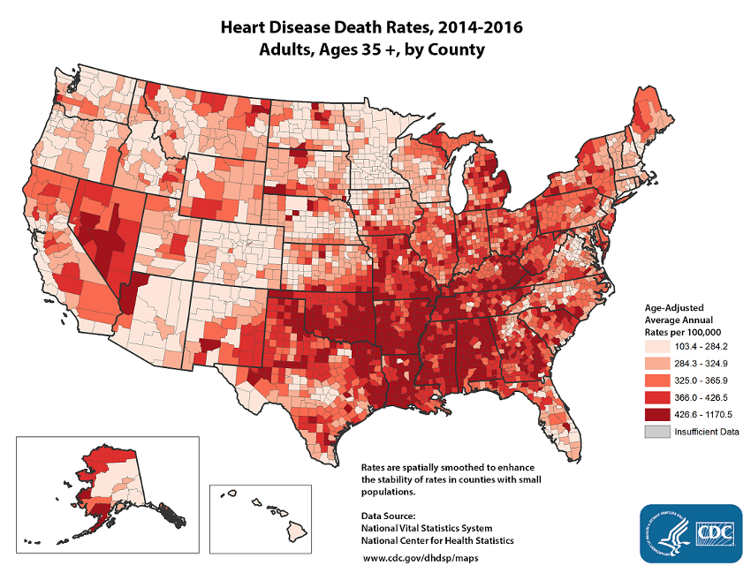
Executive Summary
1
Heart disease is the leading cause of death for men, women, and people of most racial and ethnic groups in the United States.
One person dies every 36 seconds in the United States from cardiovascular disease.
2
Heart disease may be silent and not diagnosed until a person experiences signs or symptoms of a heart attack, heart failure, or an arrhythmia.
3
About half of Americans 47% have at least one of these three risk factors: high blood pressure, high blood cholesterol, and smoking.
4

Slide 5
Research Objectives
1
Train a predictive machine learning model for early-stage heart disease detection.
2
Compare the classification performance of different machine learning algorithms.

Slide 6





Our Overall Approach
Plan
Design
Build
Finalize
Project Organization
Data Collection and Design Consideration
Core Analytics Task Execution
Make Actionable
Team Members Selection
Data Collection
Environment
Setup
Model
Assessment & Selection
Project Topic Research and Selection
High level
Data Review
Exploratory Data Analysis
Quality assurance testing
Project Brief Development
Design Considerations
Data
Cleaning
Project
Presentation
Feature
Engineering
Model
Development
Start
2 Weeks
2 Weeks
3 Weeks
2 Weeks
End
Completed
Completed
Completed
Where we are !

Slide 7

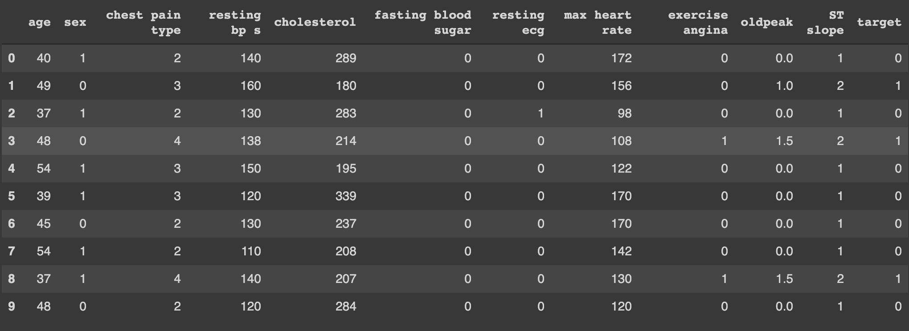
Data Overview
Combines 5 popular heart disease datasets already available independently:
Cleveland
Hungarian
Switzerland
Long Beach, VA
Statlog (Heart) Data Set.
A
Source Data
1190 by 11
1. Extract
3. Load
B
Transformed Data
918 by 11
2. Transformation
Largest curated heart disease dataset available so far for research purposes (IEEEDataPort).
Assumption: Data was curated properly from source.

Slide 8
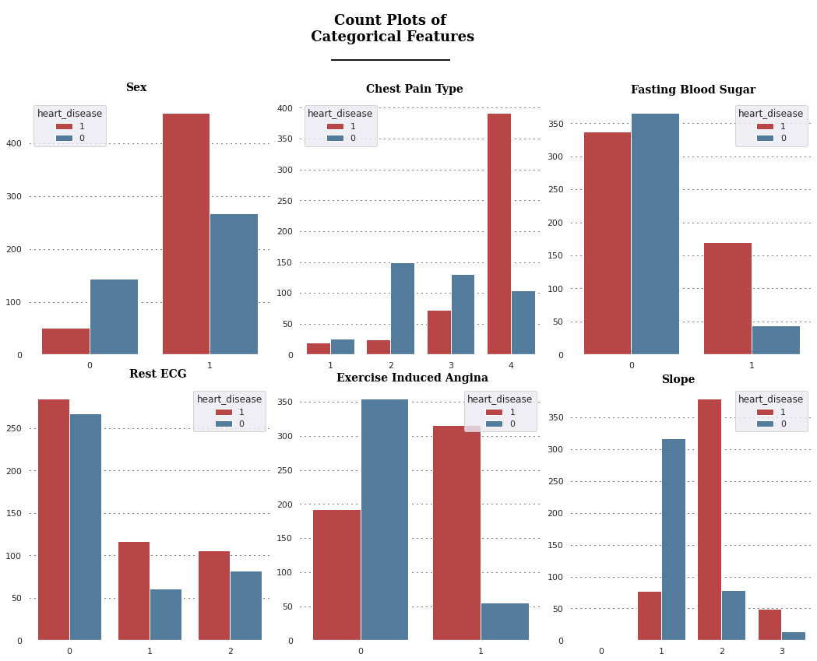
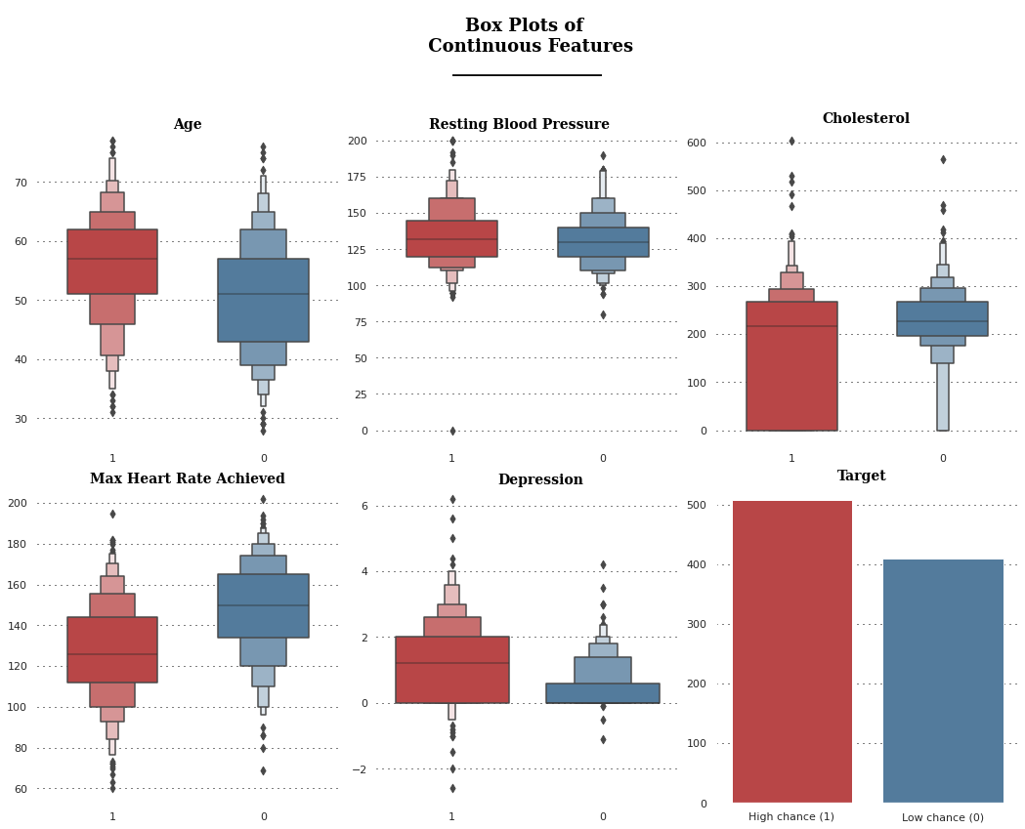
Exploratory Data Analysis – 1 of 2

Slide 9
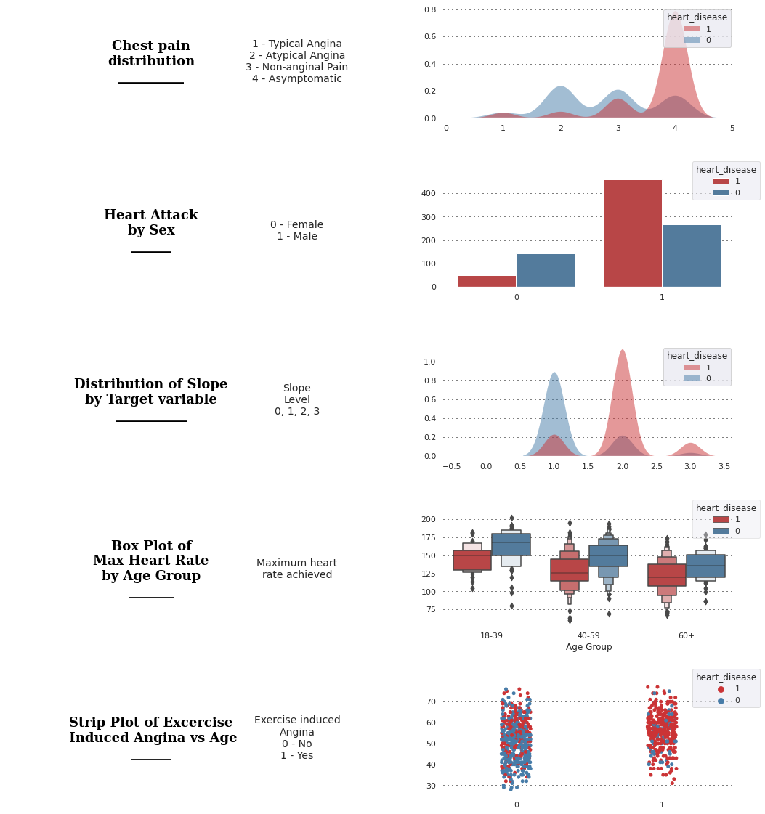
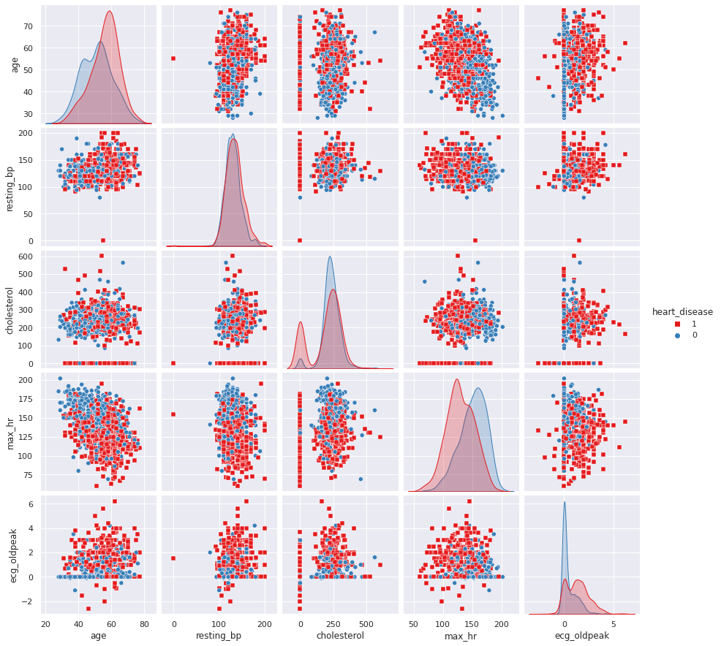
Exploratory Data Analysis – 2 of 2

Slide 10



Data Preparation
Use Underscore
Meaningful
Abbreviation
Use lower case
1
Renamed Data
Resting Heart Rate
Cholesterol
Level
2
Performed Imputation
3
Train set
60%
Test set
20%
Validation
20%
Train/ Test Split

Slide 11
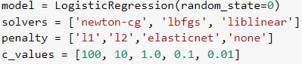
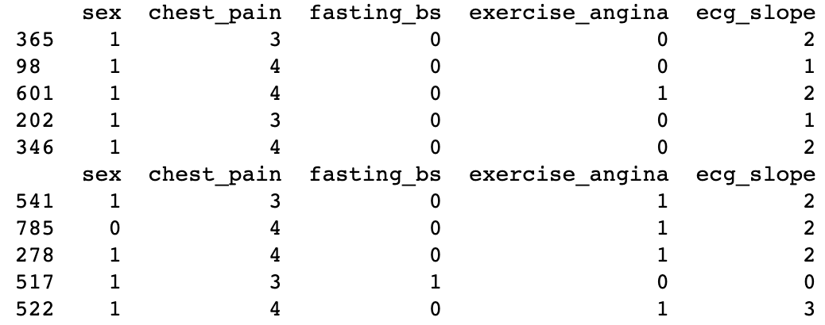
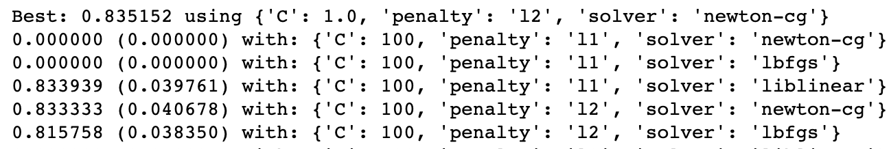
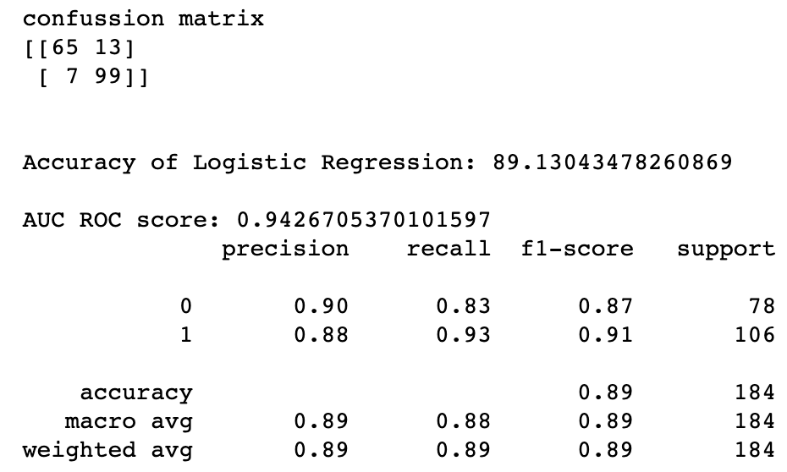
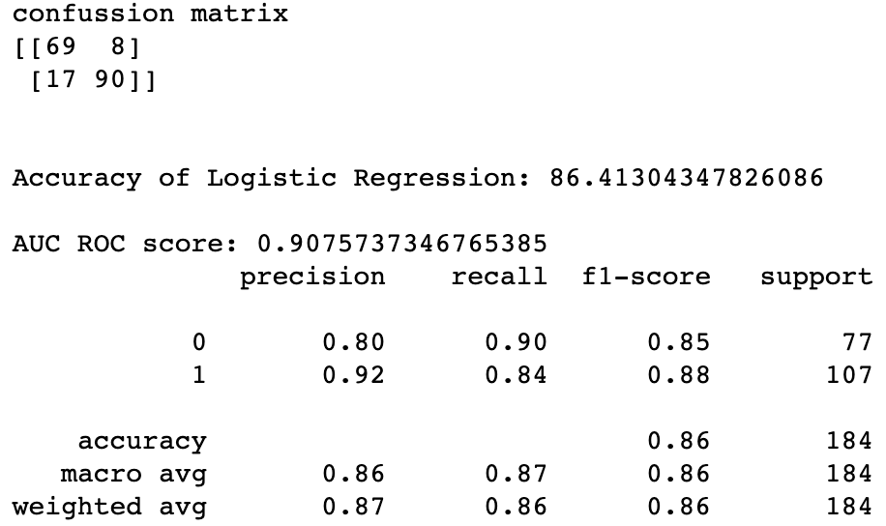
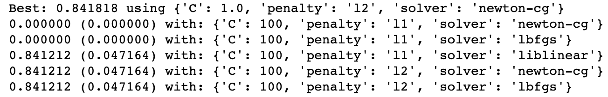
Modeling – Logistic Regression
1
Baseline Tuning with GridSearch
2
Feature Selection through RFE
4
3
Tuning Train Set with Selected Features
Evaluate on Validation and Test Sets
Validation Set
Test Set

Slide 12
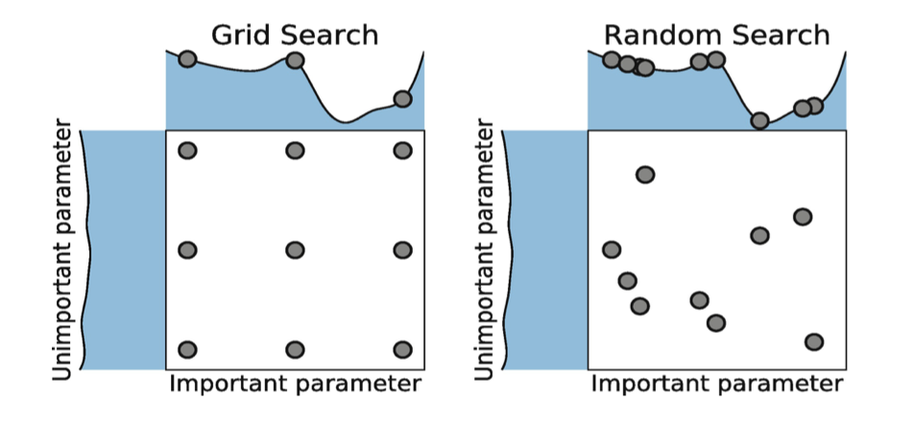
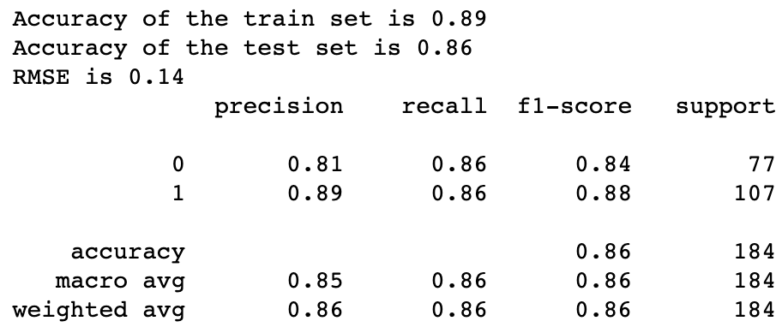
Modeling – Support Vector Machine
1
MINMAX SVM
Best parameter (CV score=0.844)
C: 100
GAMMA: 0.001
KERNEL: 'RBF’
Runtime:
10.72 Seconds
2
STANDARD SCALER SVM
Best parameter (CV score=0.836)
C: 1
GAMMA: 10
KERNEL: 'LINEAR’
Runtime:
68.98 Seconds
3
4

Slide 13
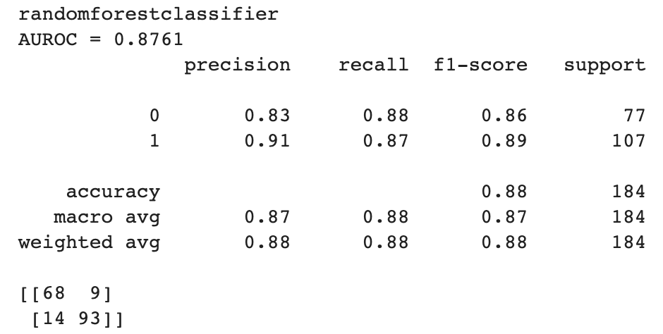
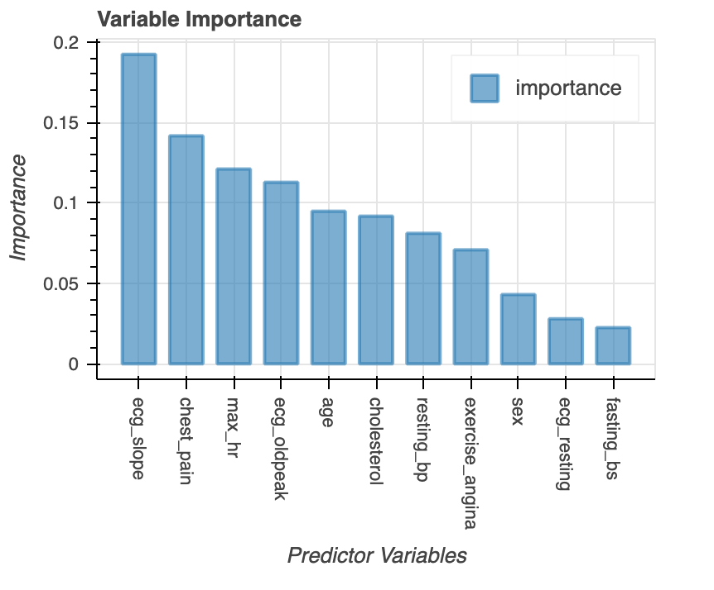
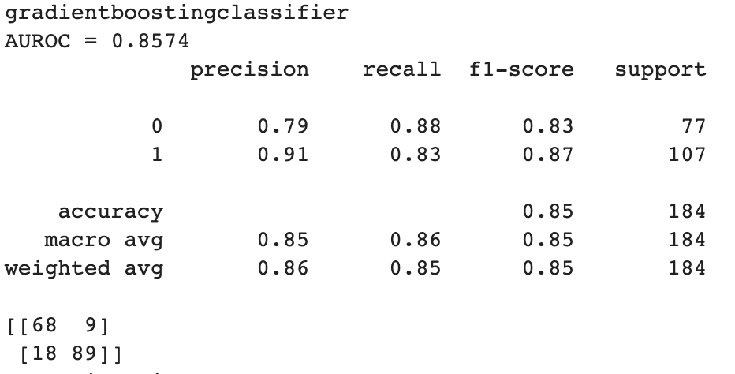
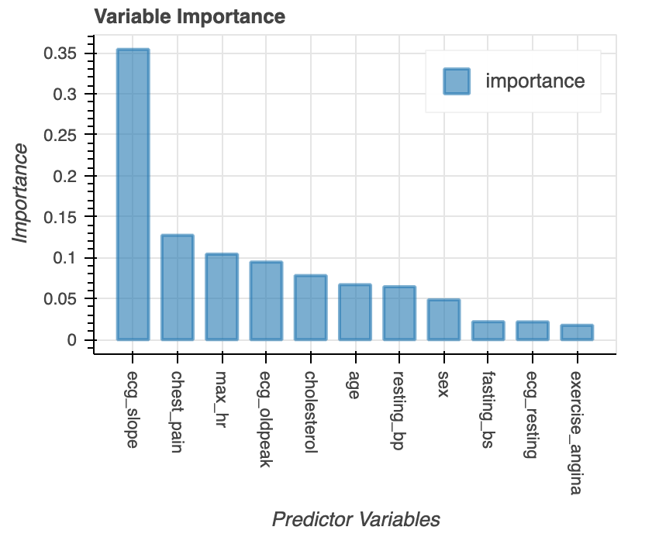
Modeling – Random Forest & Gradient Boosting
1
RANDOM FOREST
max_features | auto
n_estimators | 200
Runtime - 14.76 Secs
2
3
GRADIENT BOOSTING
learning_rate | 0.05
max_depth | 5
n_estimators | 200
Runtime- 26.81 Secs
4

Slide 14
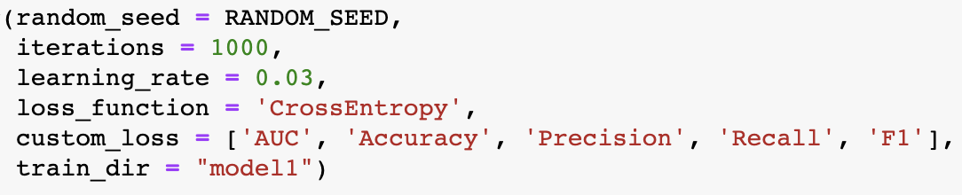
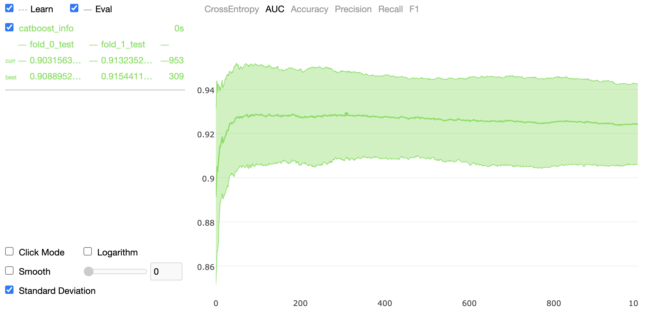
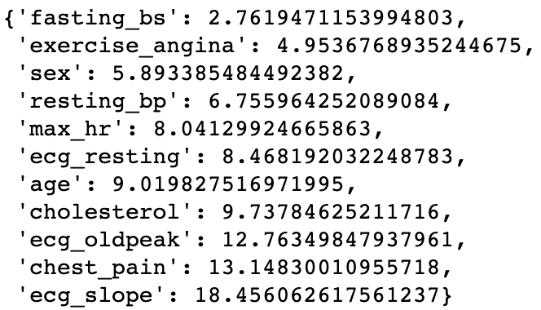
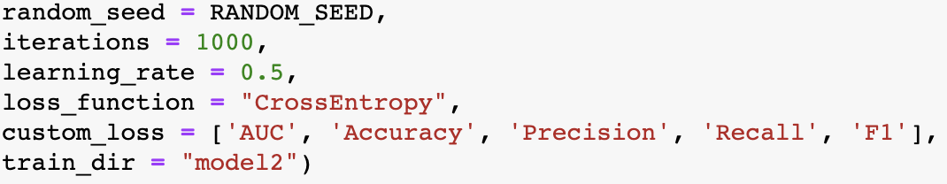
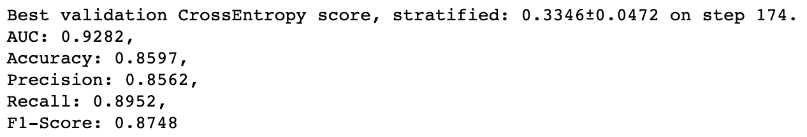
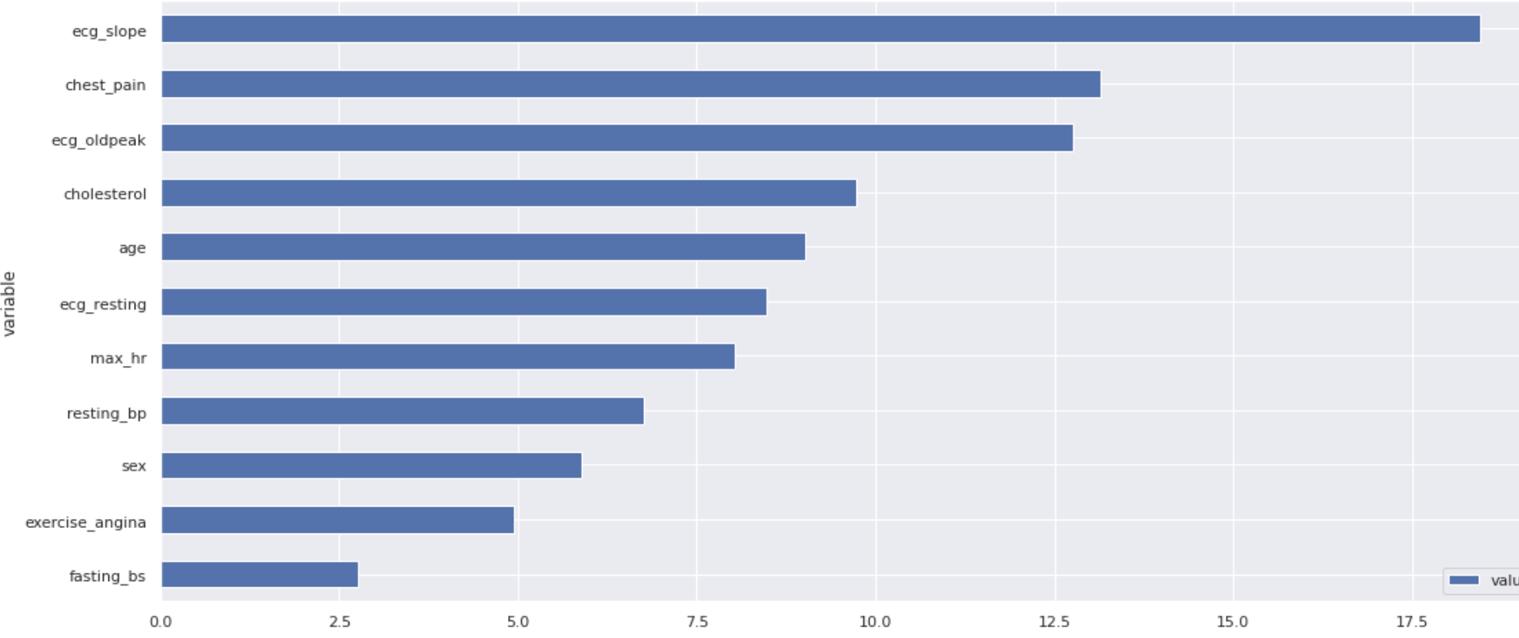
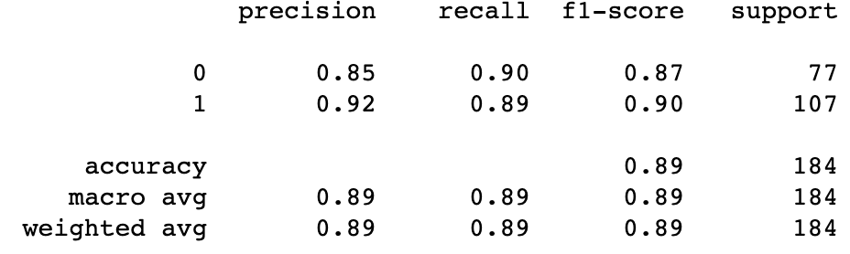
Modeling – Cat Boost
1
2
3
4

Slide 15
Modeling – Performance & Selection
Evaluation
Model | Precision | Recall | F1 | AUC-ROC | Runtime
Logistic Regression | 0.86 | 0.87 | 0.86 | 0.91 | 0.70 sec
SVM | 0.89 | 0.89 | 0.89 | 0.91 | 10.72 sec
CatBoost | 0.89 | 0.89 | 0.89 | 0.93 | 5.16 sec
Random Forest | 0.88 | 0.88 | 0.88 | 0.88 | 14.76 sec
Gradient Booting – Scikit Learn | 0.86 | 0.85 | 0.85 | 0.86 | 26.81 sec

Slide 16
Recommendations
1
Tuned CatBoost was the best performing model considering execution time, precision, recall, F1-score, and accuracy.
Add more relevant features such as smoking, diastolic blood pressure, HB1ac, triglycerides, LDL, and HDL.
2
3
More observations and deep learning models.
Classify cardiovascular risk into a multinomial ordinal variable.
4

Slide 17

Lessons Learned
Feature importance is consistent among different models.
Using Git for version control.
Complexity isn’t always better. Simpler models may yield similar results.
Be mindful of data errors such as missing values and identical records.
Compare imputation strategies especially within modeling pipelines.
Reaching consensus on scoring metrics given the context of the problem.

Slide 18
References
https://www.cdc.gov/heartdisease/about.htm
https://www.cdc.gov/heartdisease/facts.htm
https://ieee-dataport.org/open-access/heart-disease-dataset-comprehensive
https://stackexchange.com/
https://stackeoverflow.com/
https://canvas.uchicago.edu/courses/34211

Slide 19
Thank you FOR listening

